Slide 1


Slide 2

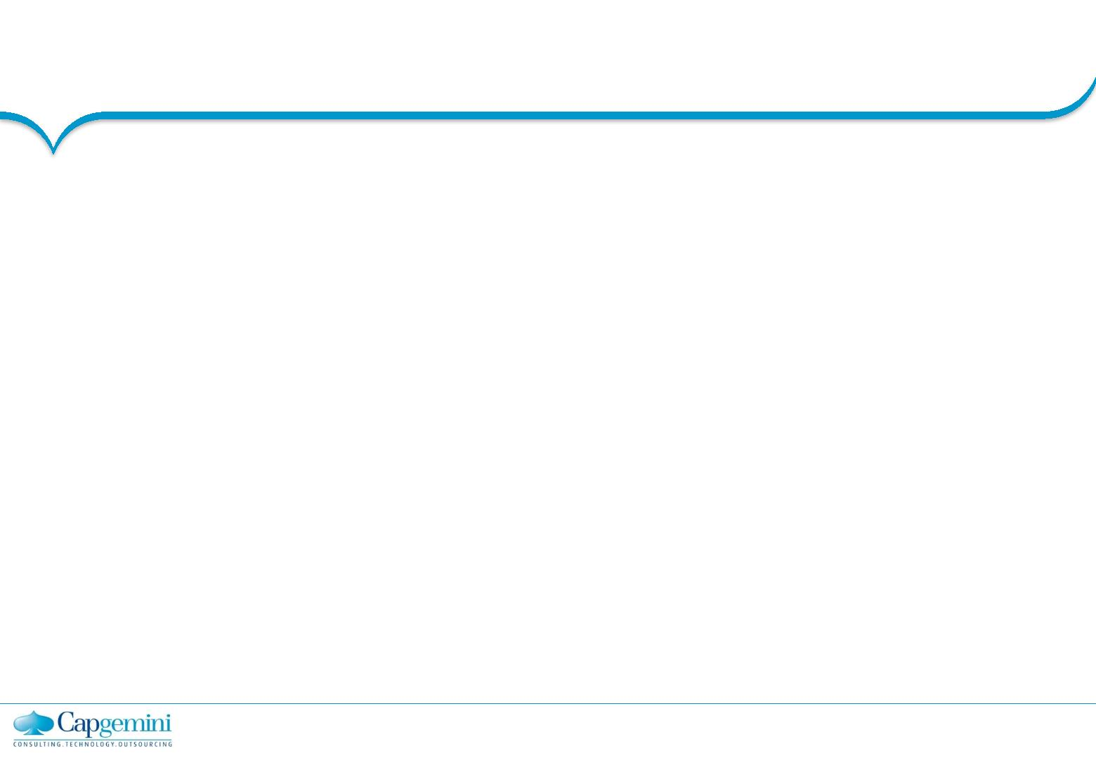
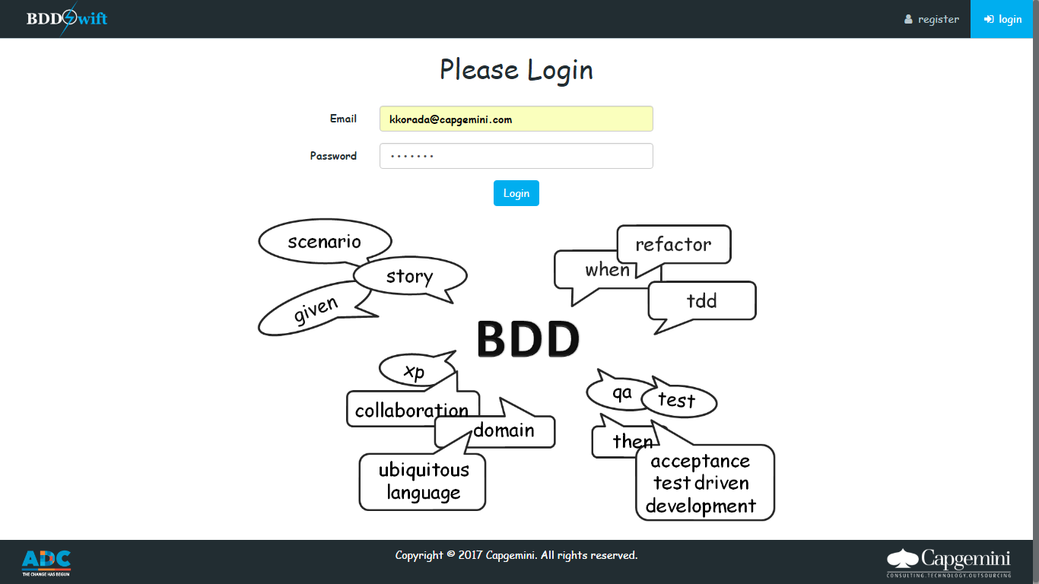
Log-In Screen

Slide 3
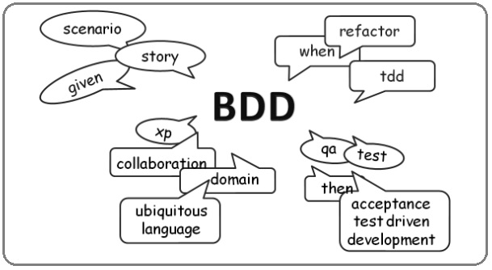
BDD which stands for Behavior Driven Development which is principally an idea about how software development should be managed by both business interests and technical insight.
BDDSwift helps in accelerating the process of gathering Business Requirements.
User Stories are written in Gherkin language( plain English like language) with
Given, When, Then constraints

Slide 4
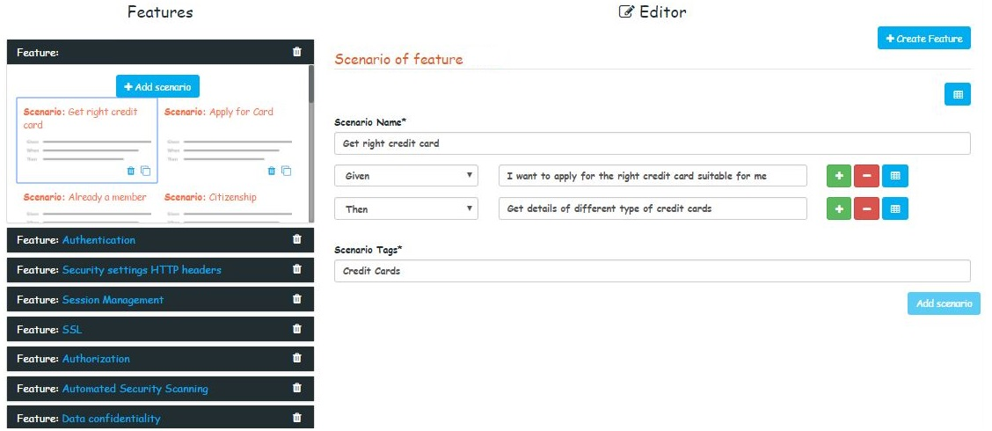
Each feature file contains 5-20 scenarios.

Slide 5
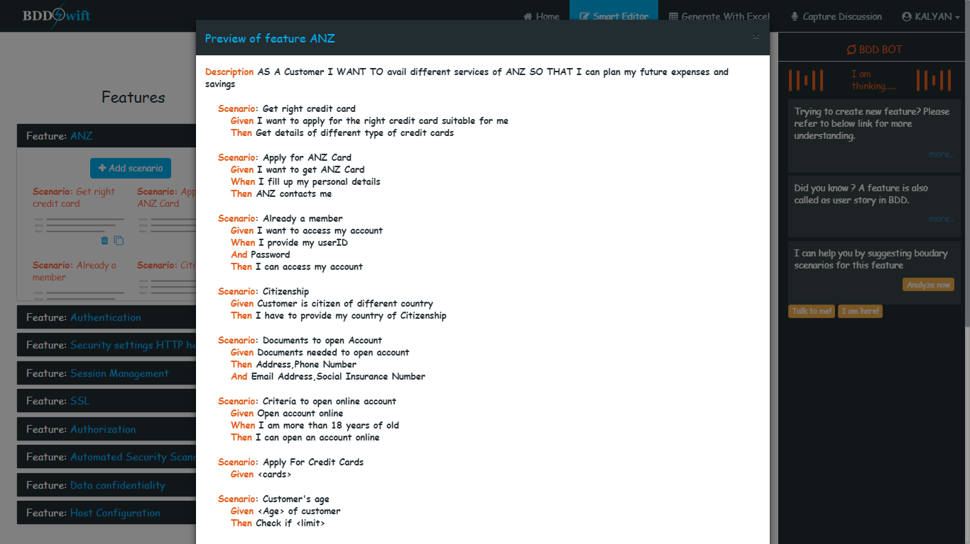
Preview Feature

Slide 6
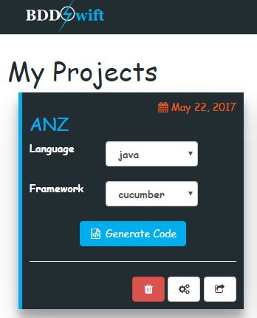
After all the scenarios are written, go to MyProjects -> name of the project -> generate code.
A .java and .class file is generated for each feature where scenarios have been written in java style.
Click to generate .java & .feature file
Click to be pushed to JIRA

Slide 7
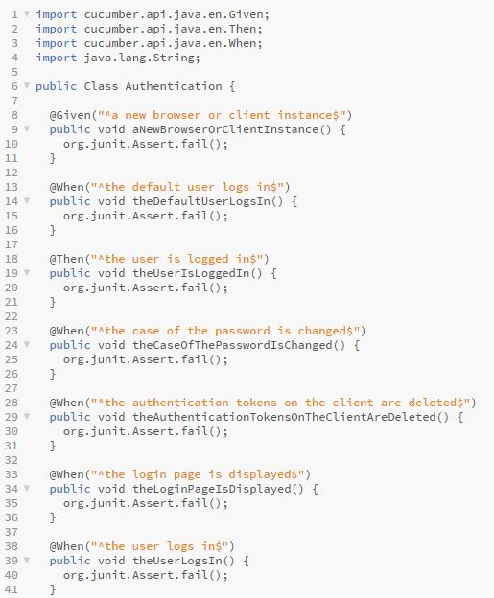
.java file
.feature file

Slide 8

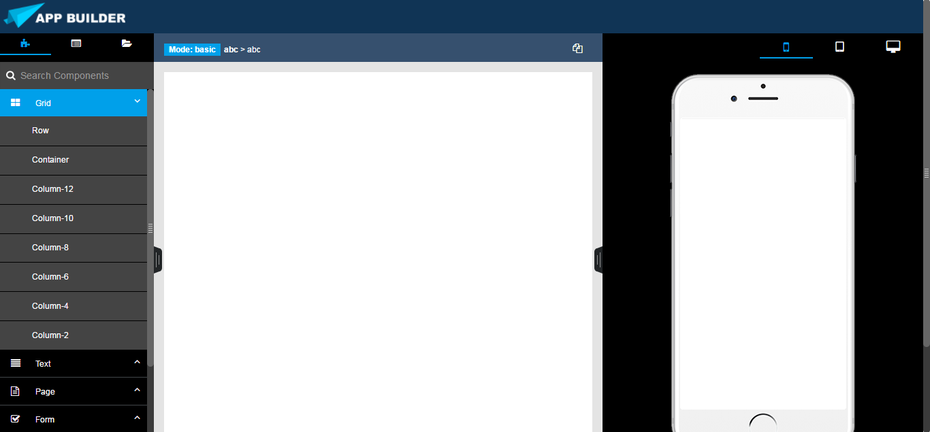
Drag & Drop HTML Design
Appbuilder is an accelerator that helps you build templates. It comes with a large number of built-in components, which you can drag and drop to assemble responsive web pages. It is built on top of the AngularJs 1.4 and Bootstrap framework, which exports clean and semantic HTML.
Blockchain Introduction
Copyright © Capgemini 2016. All Rights Reserved
13

Slide 9
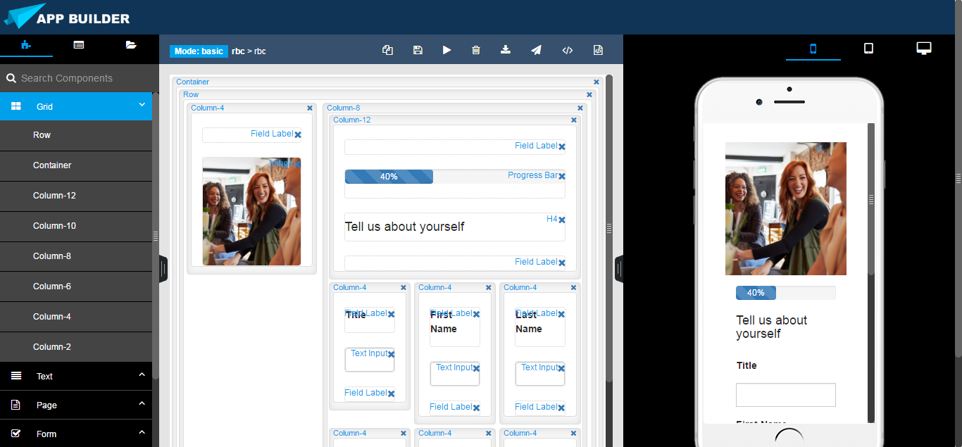
Drag & Drop
Appbuilder has Bootstrap components which can be nested in one another.
It automatically generates HTML for you, which looks as if it was written by hand by an expert.
Create Your Own Components
You can export pieces of your designs as custom templates, and have them ready to be dropped into any design you create.

Slide 10
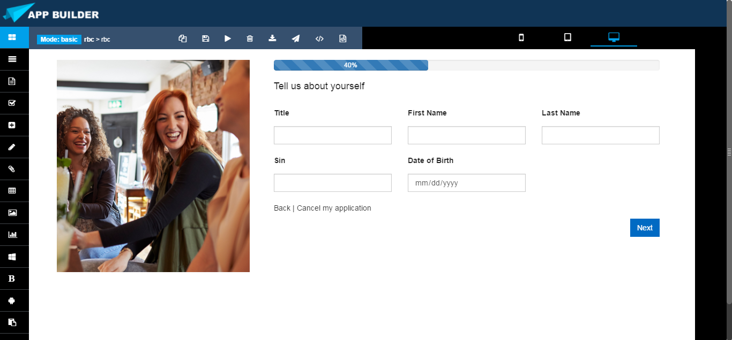
Realtime Preview
Appbuilder provides you preview in multiple devices, and every change you make within the app will be shown instantaneously everywhere.
Built with Bootstrap
Appbuilder knows how to construct a responsive webpage with valid Bootstrap, HTML5 and CSS3. It currently supports Bootstrap 3

Slide 11
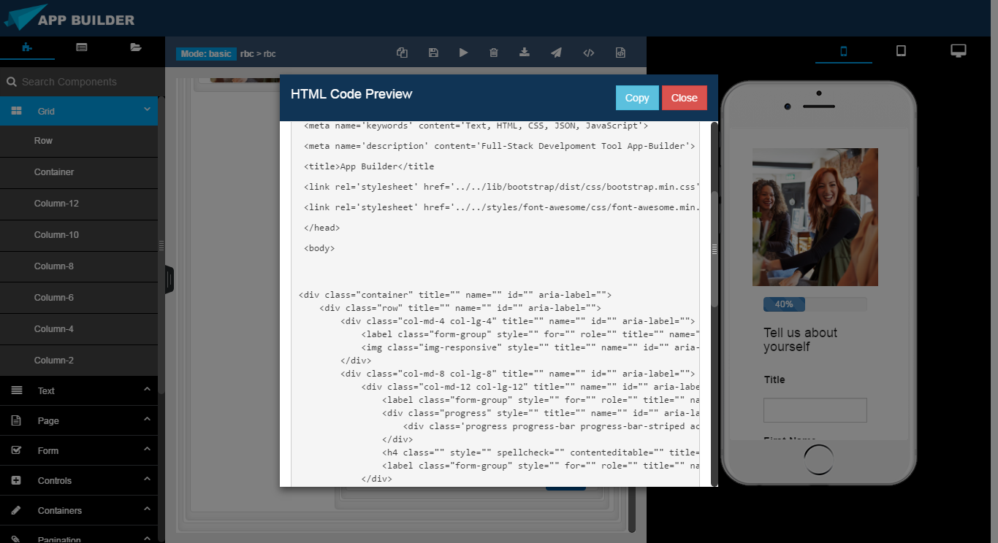
HTML Code Preview
Appbuilder allows you to view and copy the HTML 5 code generated from your design
JSON Code Preview
Appbuilder allows you to view and copy the JSON structure generated from your design which can be used to export the webpage to other machines

Slide 12

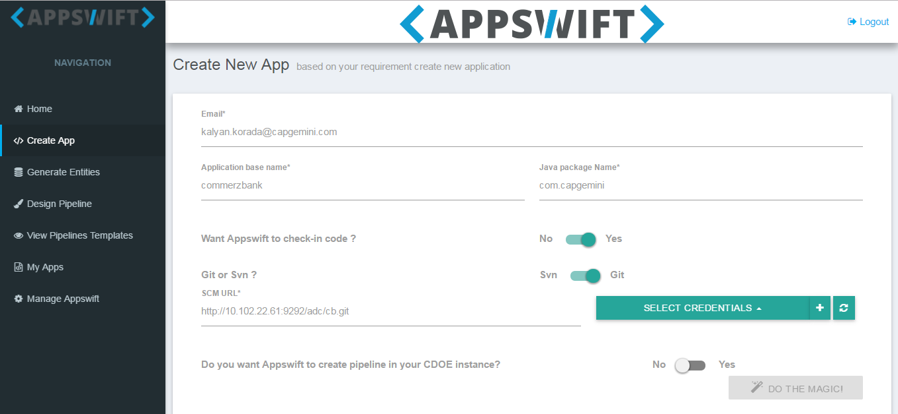
Create App
AppSwift is an accelarator used to develop quickly a modern web application using AngularJS and the Spring Framework.
It provides out-of-the-box auto-configured tooling
Eg:Yeoman ,grunt ,gulp ,bowerSync, Maven, Gradle etc.
On the server side:
Eg.Spring boot, Spring Security, Metrics Monitoring, Spring Websocket, Spring Data JPA +Bean Validation
On the client side:
Eg. HTML5 Boilerplate, Twitter Bootstrap, AngularJS, Angular 2 (beta), Sass support for CSS design, Spring Websocket
Blockchain Introduction
Copyright © Capgemini 2016. All Rights Reserved
13

Slide 13
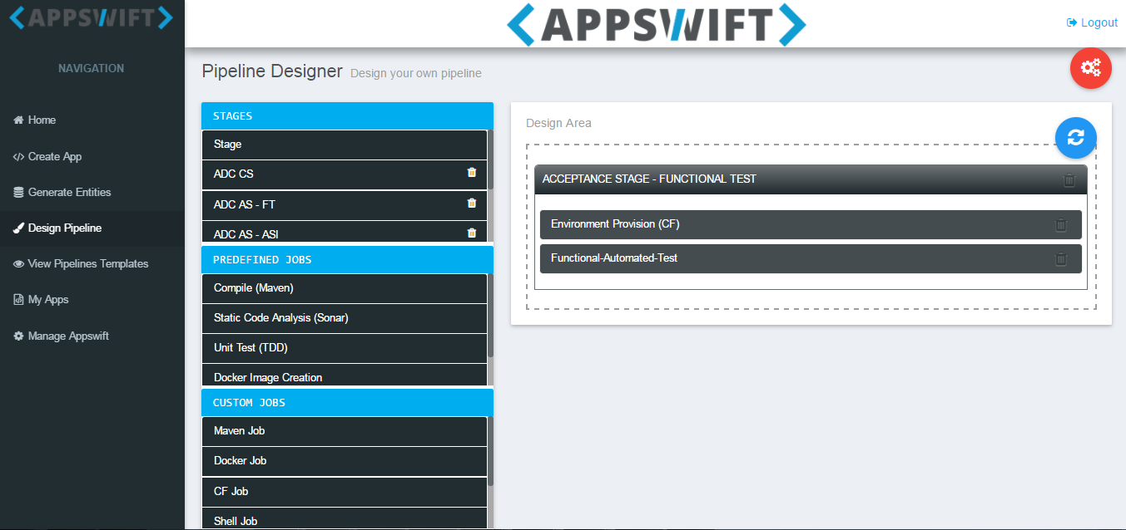
Pipeline Design
Pipeline Designer is a drag and drop interface where one can design CICD pipelines with out any hassle. Once pipeline is designed it can be deployed on to any Jenkins server remotely.
Benefits:
Real-time Visualization
No scripting required
Easy Upstream and Downstream management of jobs Prebuilt templates
BlocchainIntrduction
Copyright © Capgemini 2016 All Rights Reserved
13

Slide 14
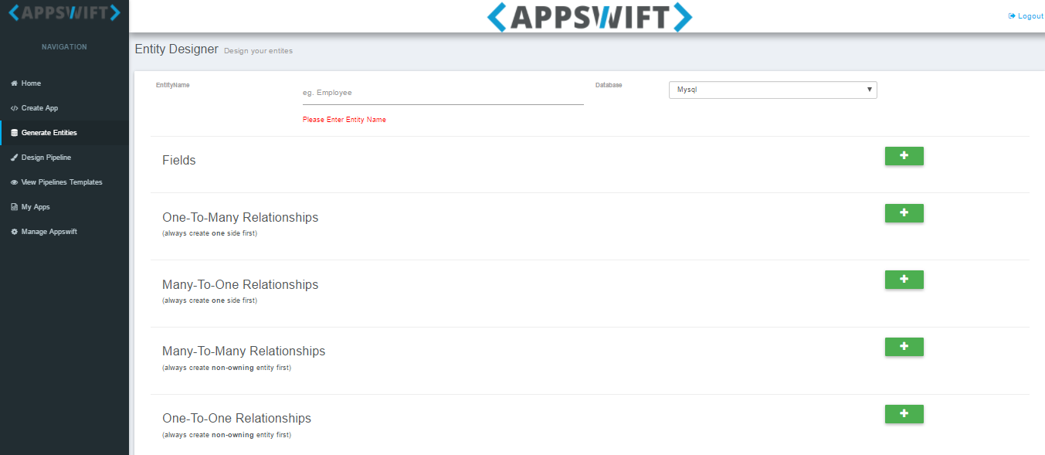
Entity Designer
Here we can design the relationship between people, objects, places, concepts or events within the system.
We can add the entities with their fields and can set the inter relation.
One-to-many
Many-to-one
Many-to-many
One-to-one
We can choose from three databases MySql ,Oracle & PostgreSchool

Slide 15

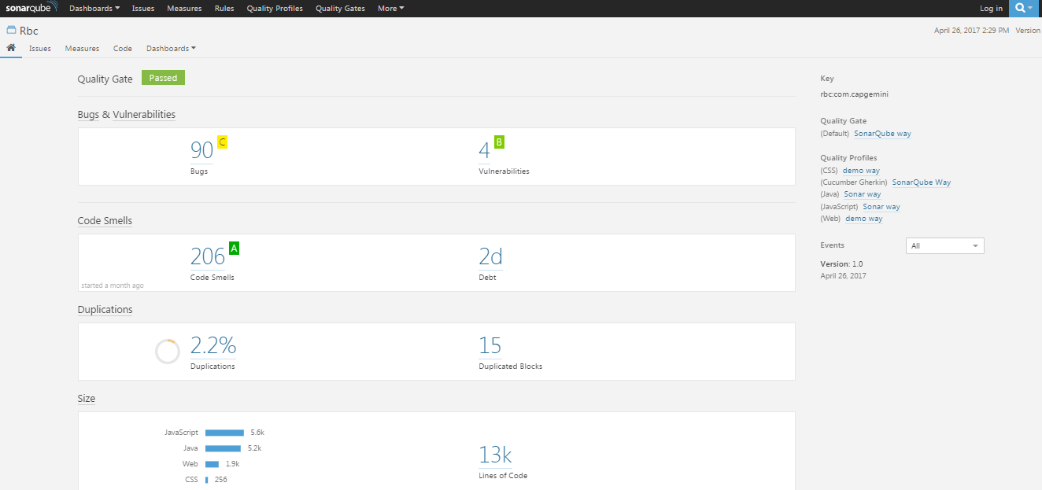
AppSwift automatically injects the code in the SonarQube through which we can continuously monitor
the code quality.
AppSwift generates 13K lines of code with 2 days of code debt and
these are default standards generated by AppSwift.

Slide 16

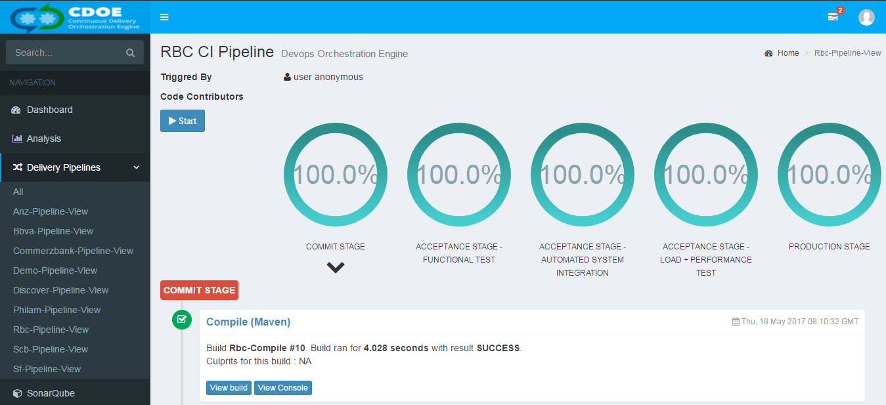
CDOE is a complete integrated DevOps tool chain.
It is a set or combination of tools that aid in the delivery, development, and management of applications throughout the software development lifecycle.
Here we have end to end delivery from commit to production stage.

Slide 17
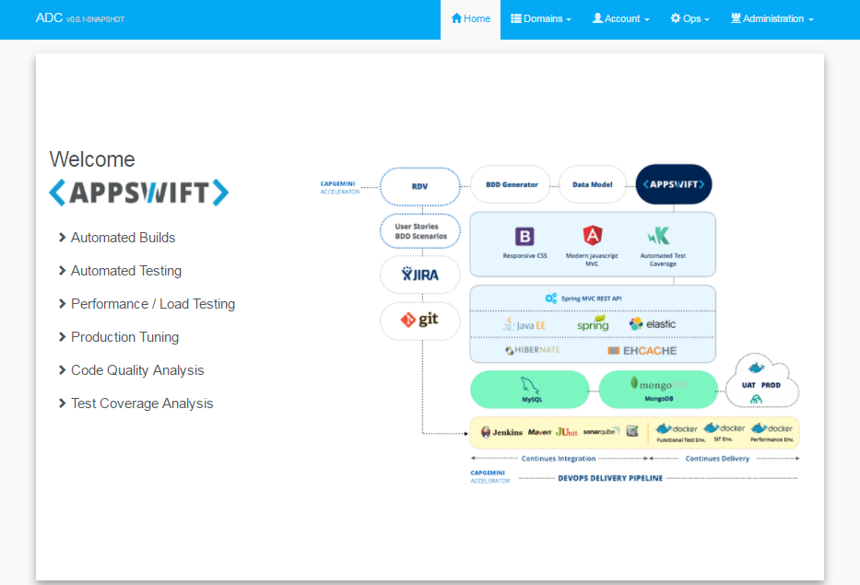
Cloud Hosted App
After being through several process & several accelerators mentioned in previous slides we will get our App on cloud which will be up and running.

Slide 18

Description:
Unmanaged code when present in the codebase shows warnings which is observed most of the times. Commonly observed problems are:
-- un-formatted code
-- unused imports
-- unused variables
-- missing annotations that lead to warnings by JVM
-- missing serial version id
To rectify the issues, “Automatic Code Quality Fix” is a must to ADC and hence ROBOQ plays a big role to automate the process.
Technology Stack:
Below technologies are used in creation of ROBOQ:
Java8
Eclipse Mars 4.5.0
Eclipse JDT/OSGi library
Maven
Dos scripting

Slide 19
Design Details:
Eclipse Container
Activator
Command Executer
Transform
Java Transform Action
ROBOQ is an Eclipse OSGi headless plugin that runs as an Eclipse Application to achieve the objective of automatic code quality fix. To auto initiate,activator component is used which in-turn calls complete flow to correct java source files.

Slide 20


